Slide 1






ADTA 5560: Recurrent Neural Networks for Sequence Data Thuan L Nguyen, PhD Final Project PRESENATANT by -yog Chaudhary

Slide 2

AGENDA TO COVER
PART I: A time-series data set
PART II: Simple RNN neural network with Sine Wave Data
PART III: RNN: LSTM Cells: Core Concepts
PART IV: LSTM neural network with Time-series Data
PART V: Redesign the LSTM Neural Network to improve performance
PART VI: Compare Network Performance
PART VII: Project Report

Slide 3
A TIME SERIES DATA SET
I chose the data set named Airline Baggage Complaints. The dataset has 253 data points, with monthly observations of each airline during the period under study. Air travel may not be free from some irritating incidents that can't be avoided, such as flights being delayed or even canceled, or experiencing baggage problems.
It comprises baggage complaints for three airlines observed over a period against the frequency and type of complaints with regards to baggage. The following describes the dataset for each airline observed every month from the year 2004 to 2010.
Each of the monthly observations for every airline was described by the following variables: Airline, Date, Month, Year, Baggage, Scheduled, Cancelled, Enplaned

Slide 4
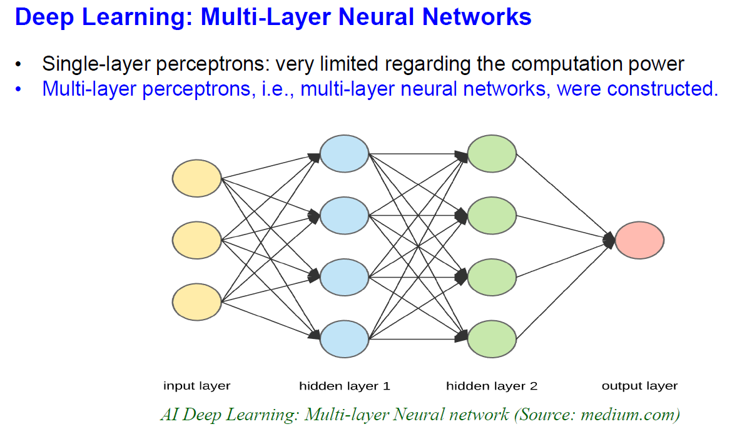
RNN: Simple RNN with Sine Wave Data
This Architecture consists of two sections. One is Simple RNN= Vanilla RNN and the Feedforward Neural Network.
The Feedforward Neural Network consists of a fully connected layer

Slide 5
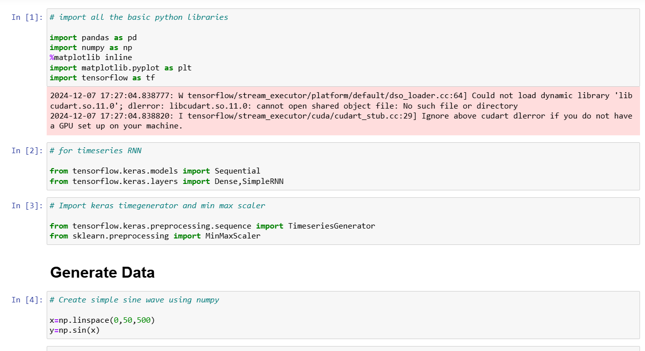
Build Train and Test Recurrent natural Network
we need to build a Timeseries Generator. We are going to build a Sine wave, or we need to generate the batteries to fit into the model when between. Keras is the best tool to build, test, and train the modal.
Using the Minmax scaler we will generate sine waves. Once generated, we need to do some preprocessing of the data. To do this we are going to Normalize the data into the range

Slide 6
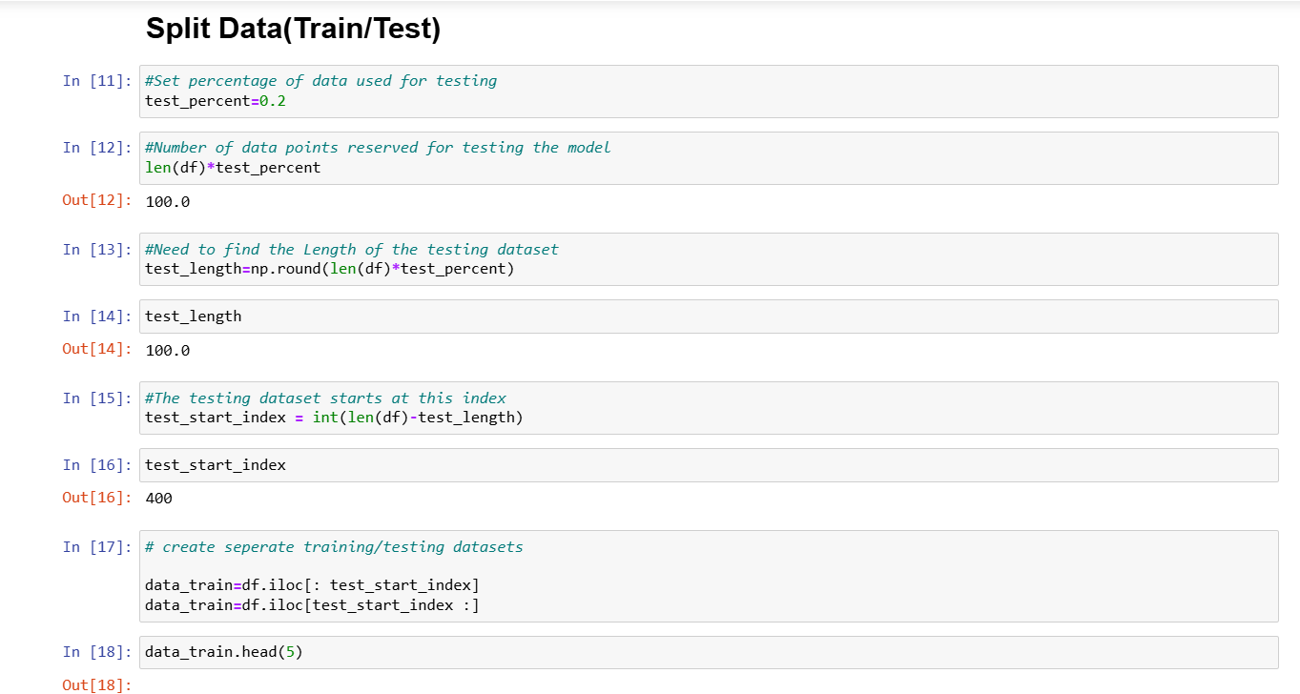
Split data-Train/ Test
We need to set 20% for this project. We have 500 data points. We need to split the data frame into two data frames. The start index is 0 to 50. We will get 500 data points of the data frame. One is for training, and one is for testing. To normalize the data. We used to class call n=minmax scaler. We need to train this scale, and we use it for the data frame to fit into the trained scale

Slide 7
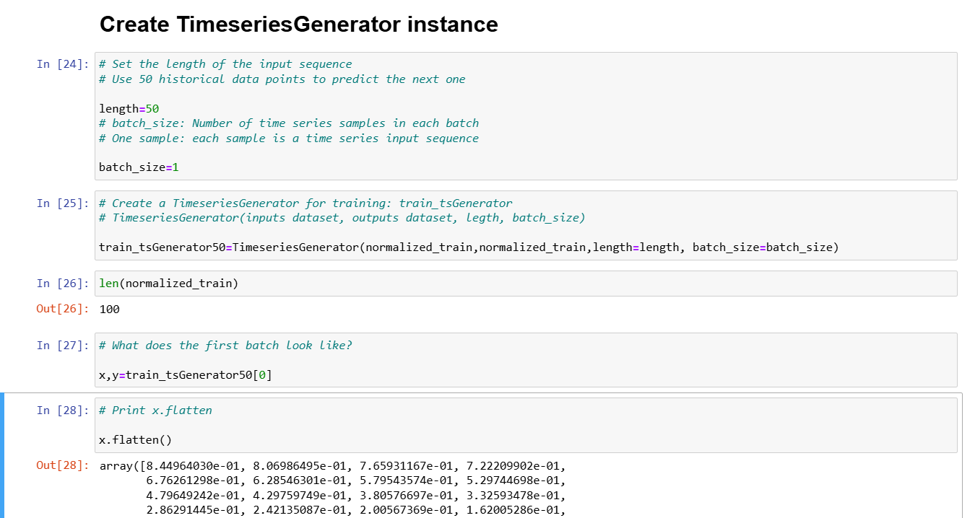
Build and Train
we need to build a Recurrent modal. We need to specify the features. The data frame has only one real attribute. We have only one feature. We will use keras to use several APIs and we also use sequential API. To build a modal in keras, we named it modal.
We need to add a layer as it is empty now. We have Vanilla RNN a single layer and the second sub-network is a feedforward network. We will add a simple onion layer to the modal. We need to peel Simple RNN, and we will use 100 neurons. in this project the input sequence, the number of historical points is 50 and we can use it comfortably. Once the layer is created, we need to shape it.

Slide 8
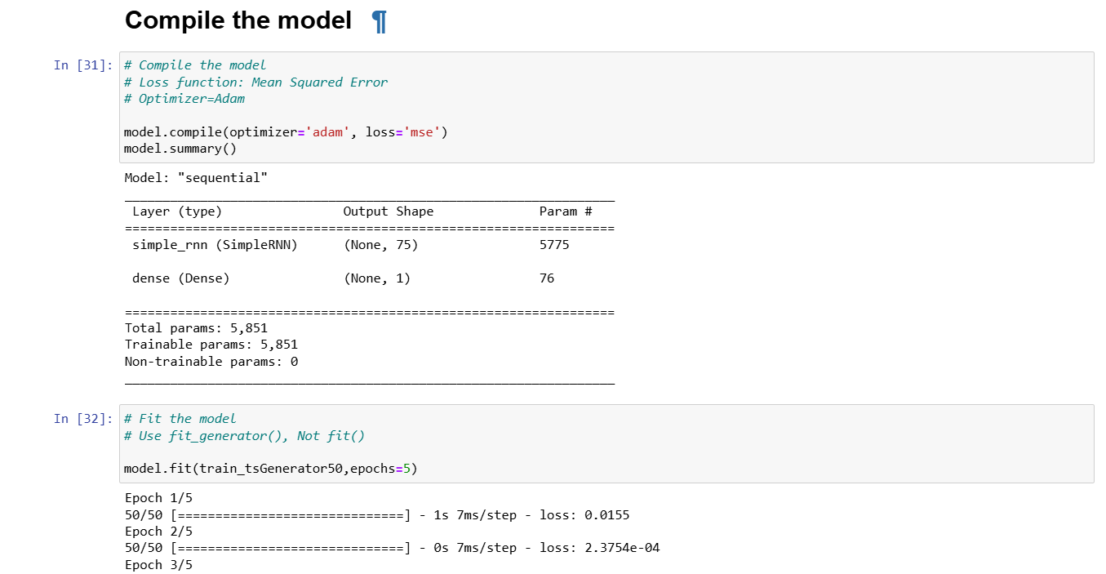
Train and Fit
To train a modal we will use a method called fit generator. Keras offers a fit method. We must fit or inject as batches as input in a modal. We will use a time series generator. We will use two parameters namely train_tsgenerator and epoch.

Slide 9
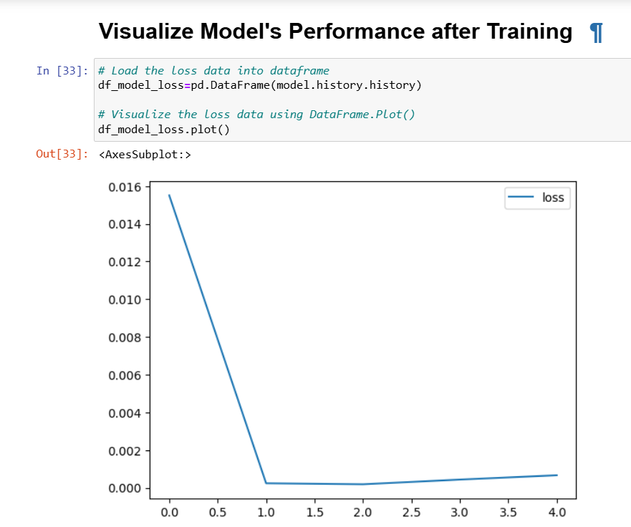
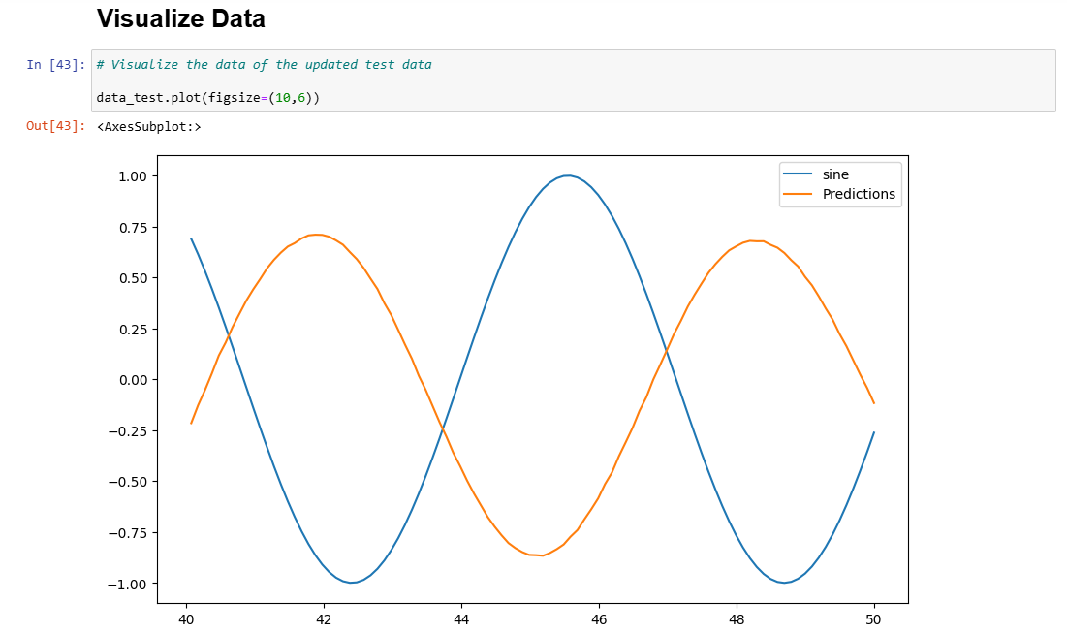
Evaluate Model on Test Data
We have only one sample. In this sample, we have 50 data points. and these are the values of one feature. That is 3 dimensional. First, we need to declare an empty list to predict the value. Next, we need to get the first batch of the input sequence

Slide 10
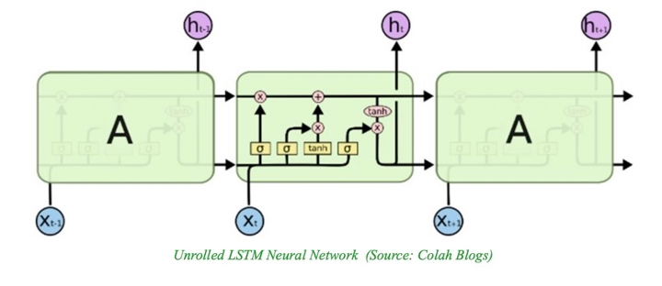
The core concept: The Cell (C) state of the LSTM cell. • A flow in a channel • A snapshot of the cell state
The Long Short-Term Memory (LSTM) neural network was proposed by German researchers Sepp Hochreiter and Juergen Schmidhuber in the mid-1990s as a solution to the vanishing gradient problem.

Slide 11
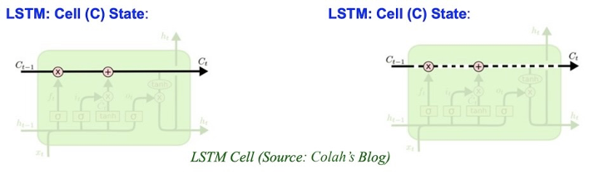
ALGORITHMS USED
Cell (C) State: LSTM Cell
• In addition to the H state, or Hidden state, an LSTM cell has a C state or Cell state.

Slide 12
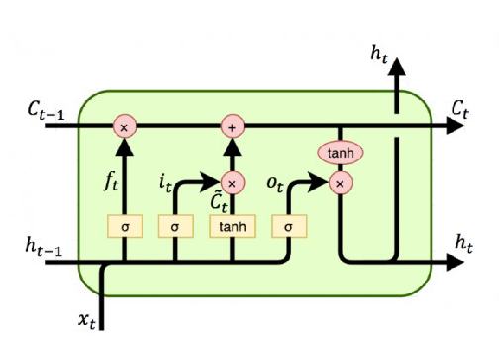
A CHANNEL'S FLOW A SNAPSHOT of a CELL STATE
Information can travel freely along the channel, without being slowed down, from beginning to conclusion.
No matter how early in the sequence the information in a cell is, the Cell (C) State can "memorize" it at each time step. At all or a subset of its local minima, the complete plot and record weights and biases. We'll end up with numerous sets of neural networks in a short amount of time, each of which will make fewer errors.

Slide 13
The flow of information in an LSTM cell occurs in four steps:
Step 1: Forget the gate
Determine whether information from the preceding Cell state Ct-1 should be eliminated (because it is irrelevant or inconsequential) or maintained (relevant or significant
f(t) = σ(Wf * [ ht-1, xt] + bf
Step 2: Fill in the blanks with Gat. Determine which of the inputs (ht-1 and xt) is useful and should be included in the new current Cell state C(t).
The flow of information in an LSTM cell occurs in four steps
Step 3: Activate the output gate
At time step t, compute and retrieve the new current Cell state C(t).
Step 4: Output Gate

Slide 14
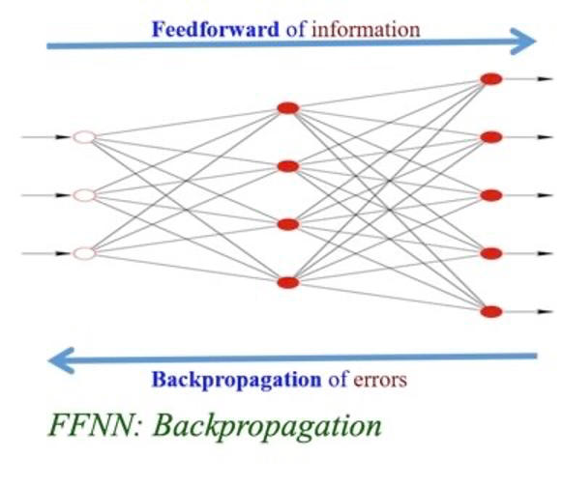
Backpropagation: In Feedforward Neural Network (FFNN)
Given a very simple feedforward neural network (FFNN) that has only three nodes:
--) Input node: I1
--) Hidden node: (H1 – HA1) representing a hidden layer
--) Output node: (O1 – OA1) representing the output layer

Slide 15
The Gates (Forget, Input, and Output) of the LSTM cell.
Information can be added or withdrawn to the flow, i.e., the cell state, via gates along this path, transferring pertinent information along the sequence chain.
In other words, the gates are used by an LSTM cell to control the flow of information traveling down the processing path of the sequence chain.
In an LSTM Cell, there are three gates: Forget, Input, and Output, each with its own sigmoid activation function.

Slide 16
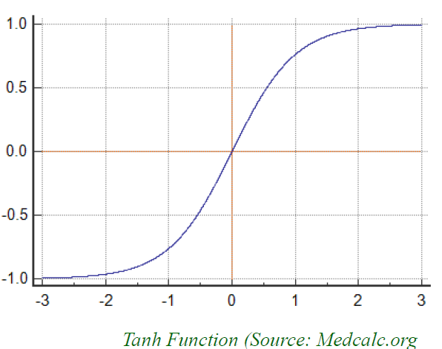
Tanh Activation Function in LSTM Cells
Tanh activation functions are also found in LSTM cells.
Tanh activation functions have values ranging from -1 to 1.

Slide 17
Similarities and the differences between the Cell (C) state in LSTM cells and the Hidden (H) state in the Simple RNN cells
1. Cell state:
a. Long-term memory of the model, only part of LSTM models
b. LSTMs are usually better at dealing with long-term dependencies, because of their capacity to store and load beliefs that are important at different parts of the sequence.
2. Hidden state:
a. Working memory, part of LSTM and RNN models
b. Working memory capability that carries information from immediately previous events and overwrites at every step uncontrollably present at RNNs and LSTM

Slide 18
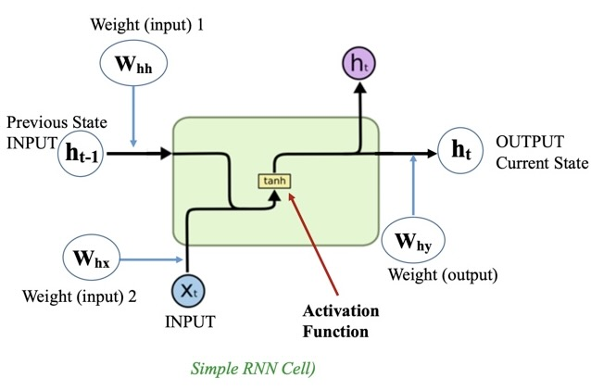
Hidden (H) state in the Simple RNN cells
An RNN has a looping mechanism that acts as a highway to allow information to flow from one step to the next. Passing Hidden State to next time step. This information is the hidden state, which is a representation of previous inputs

Slide 19
RNN: LSTM with Time-Series Data
There are several different series. First, we need to import basic libraries. Matplotlib is used for visualization. We will use a special time series RNN that is dropout. It is a fully connected layer. MLP is a multi-layer. We need to import from keras for that we will use a time series generator to generate time series input

Slide 20
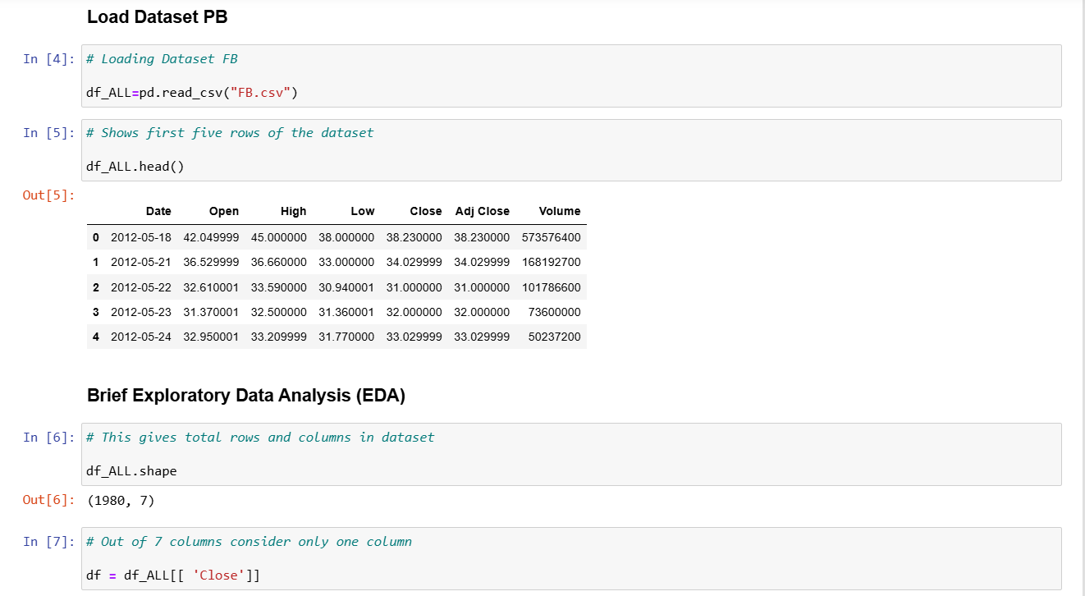
RNN: LSTM with Time-Series Data
The forms can be shown. It contains 7 characteristics and 1980 forms. Every attribute is variable. It is stated that the volume is an integer. The min, standard deviation, and max are included in the statistical summary of the numeric properties.

Slide 21
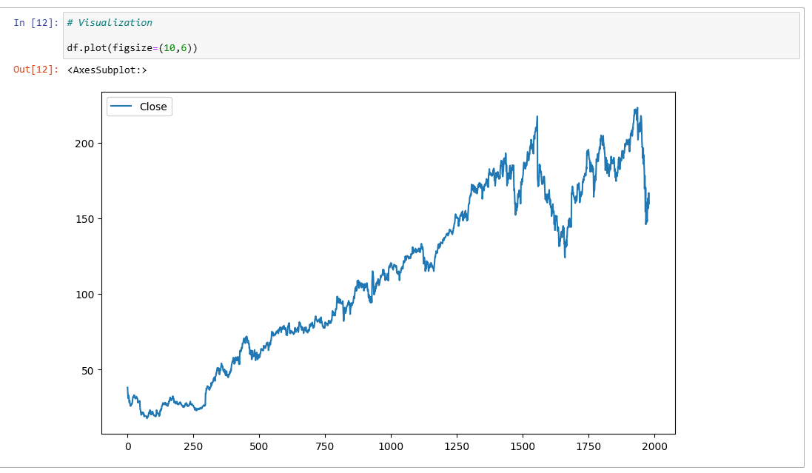
RNN: LSTM with Time-Series Data
We will get accurate data. Here we have performed one time series. If we count index from zero, the index of this should be 4. I will start at 4 and just before and it is one time series. We will visualize time series. However, we will figure out one of them attribute that is closing price.

Slide 22
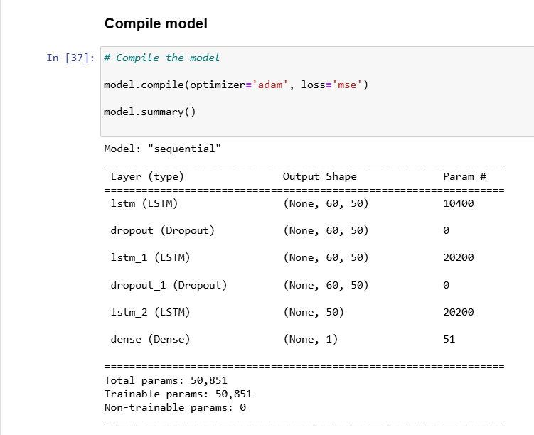
RNN: LSTM with Time-Series Data
The data must now be normalized into ranges from 0 to 1. We can perform better. The Minmax scaler class and tool will be used. Hence, if we find a fit with the data training, we will set it up and normalize the data

Slide 23
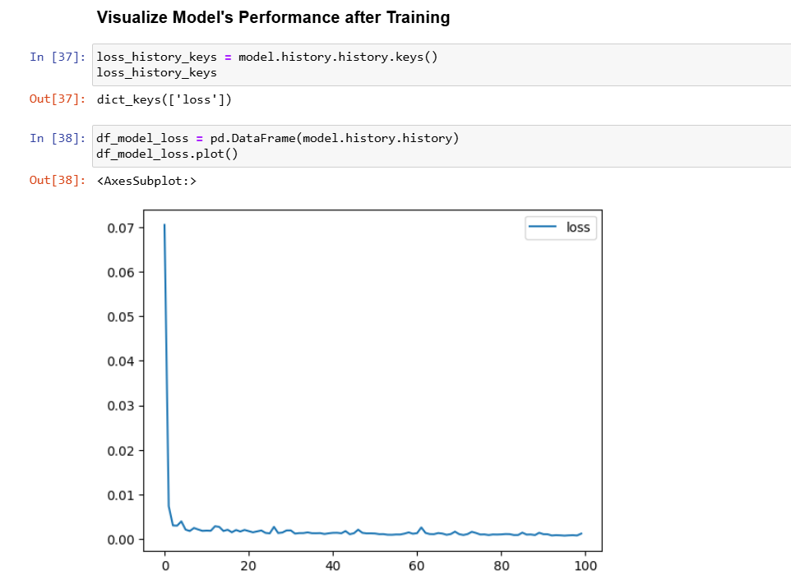
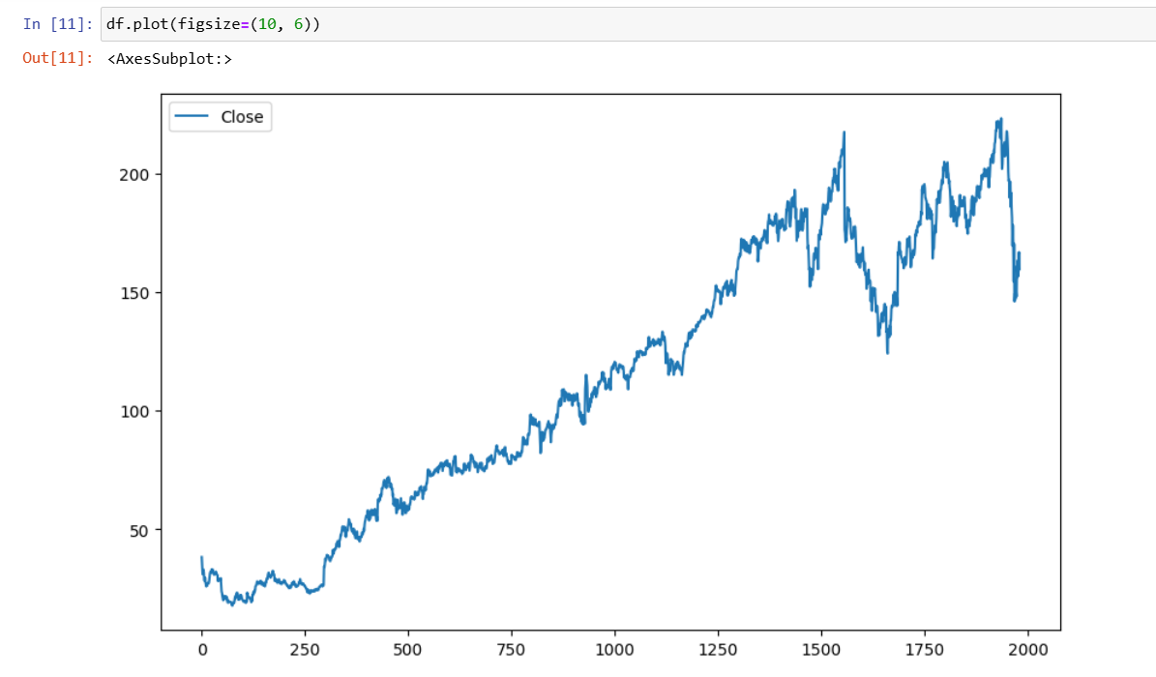
RNN: LSTM with Time-Series Data
We'll use the standard fit function. There will be 100 epoch ids visible. 37 batches must fit into the input sequence for each stage. 37 steps are what we are practicing. We will execute 37 batches of the input sequence during the initial iterations, and the loss is 0.0027. the loss declines in size.

Slide 24
Summary of Core Parameters: Network Design
1. Data set used: Stock price dataset
2. Percentage of data for testing – Test percentage is 10%
3. How many layers of LSTM – 2 Layer LSTM
4. Number of neurons in each LSTM layer - 25
5. Any Dropout layers? Yes
6. If with Dropout layer: the percentage to dropout is 20%
7. Length of the time-series input sequence = 500
8. Batch size for training = 32
9. Batch size for testing = 1
10. Number of epochs for training = 100
11. Model used: LSTM Kera Sequential

Slide 25
Redesign the Neural Network
The forms can be shown. It contains 7 characteristics and 1980 forms. Every attribute is variable. It is stated that the volume is an integer. The min, standard deviation, and max are included in the statistical summary of the numeric properties.
We'll gather reliable information. Here, we've run a single-time series. This should have an index of four if we start counting from zero. I'll begin right before four, and it’s a one-time series. Another dataset and the closing price will be considered.

Slide 26
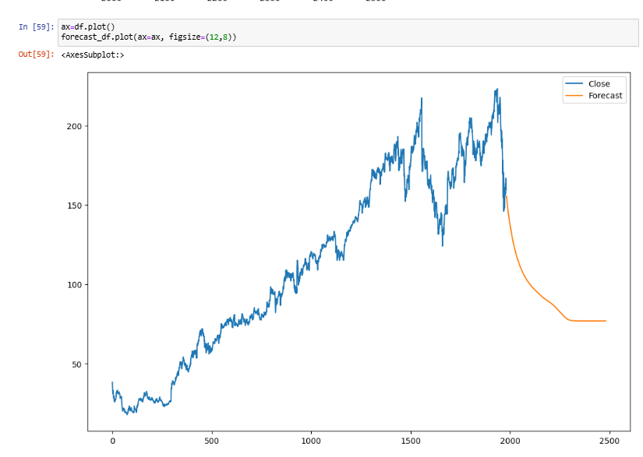
Visualize Final Output
The data must now be normalized into ranges from 0 to 1. We can perform better. The Minmax scaler class and tool will be used. Hence, if we find a fit with the data training, we will set it up and normalize the data. To train the modal, we need to develop a time series generator.

Slide 27
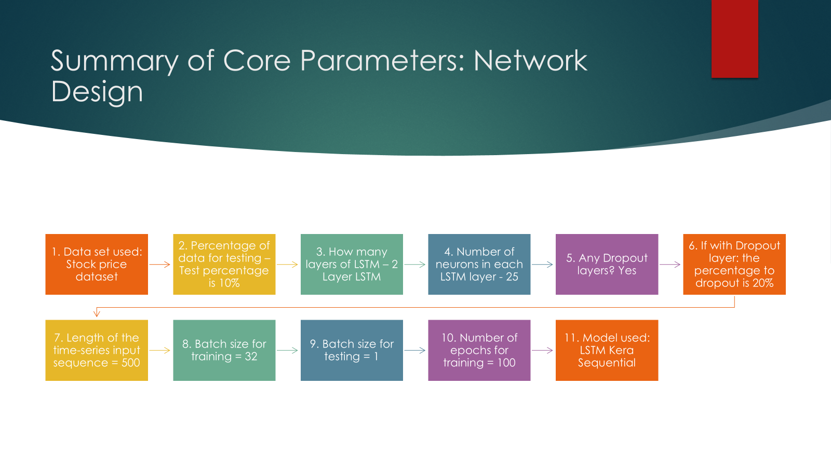

Slide 28
Comparing two results
Percentage of data for testing – Test percentage increased from 10% to 20%
Number of neurons in each LSTM layer - increased from 25 to 50
If with Dropout layer: the percentage to dropout is increased from 10% to 20%
Batch size for training = increased from 32 to 40
Number of epochs for training = increased from 40 to 100

Slide 29

Introduction section to introduce the project
RNNs are a type of neural network where the output from one phase is used as the input for the following one. In conventional neural networks, all the inputs and outputs are independent of one another.
The goal of the LSTM recurrent unit is to "remember" all the network's prior data while "forgetting" unimportant information.
The hidden layer of the LSTM is a gated unit, or gated cell, which is the primary difference between RNN and LSTM architectures

Slide 30
What I have done in PART III, IV, V and VI in the final project
For time-series forecasting, we must consider and pinpoint data correlations and patterns in order to provide prediction outcomes for sequential data that behave in a manner akin to that of the human brain.
The words "but" and "terribly exciting" in part II, on the other hand, should be recognized by an RNN, and after examining the entire sequence, it should be able to determine that the phrase has shifted from negative to positive

Slide 31
What we have learned from the models (Simple RNN and LSTM) and what he/she has experienced while working with them (build, train, test, and forecast)
A recurrent neural network aims to model time- or sequence-based data. Recurrent neural networks are used in a variety of applications, including natural language processing (NLP), stock price forecasting, predicting energy demand, and more.
By carrying over the hidden state from one step to the next and mixing it with the input, recurrent neural networks may learn from data sequences. A type of RNN that makes use of both special and conventional units is the LSTM network.

Slide 32
Conclusion section to conclude the project report.
we learned about RNN, its benefits and drawbacks, and how LSTM varies from and addresses the shortcomings of a straightforward RNN model.
LSTM also includes a concealed state in addition to cell states. "Gates" govern the cell state, which has the power to add or remove data from the cell. Theoretically, this "cell" should allow LSTM to tolerate long-term dependency.
Depending on the project, we also imported a data file that was divided into portions for the model's training and testing. ' How to simultaneously generate an LSTM model with multiple parameters (drop out, number of layers, thick layer, etc.).

Slide 33

Thank You

